Slide 1




QUELLIFY
Smart way to Learn and Grow
BASIC INFO-:
Project Name -: Quelify
Technology used -:Flask & MongoDB
Presented by -:
Tejus Gupta , Abhishek panwar, Dhruv Gupta, Nirdesh Sharma
Under the guidance of -:
Retu Mam

Slide 2
QUELLIFY
Smart way to Learn and Grow
Presentation outline -:
Introduction | 3
Problem statement | 4
Our solution | 5
What we are offering | 6
Our mission and vision | 7
Objective of the study | 8
Methodology | 9
Hardware and software used | 10
DFD/Flow chart of the study | 11
References | 12

Slide 3

QUELLIFY
Smart way to Learn and Grow
Introduction
Discover a learning experience that goes beyond the traditional classroom.
Our career paths and roadmap are crafted by experienced educators to provide you with the skills and knowledge that you need to thrive in today's fast-paced world.
From business and technology to arts and personal development, our diverse roadmap catalog ensures that you can explore and excel in your areas of interest.

Slide 4

QUELLIFY
Smart way to Learn and Grow
Identified problem
Discover a learning experience that goes beyond the traditional classroom.
Our career paths and roadmap are crafted by experienced educators to provide you with the skills and knowledge that you need to thrive in today's fast-paced world.
From business and technology to arts and personal development, our diverse roadmap catalog ensures that you can explore and excel in your areas of interest.

Slide 5

QUELLIFY
Smart way to Learn and Grow
Solution
At Quellify , we believe that education has the power to transform lives. With the rapid advancements in technology, we recognize the need to provide innovative and accessible learning solutions for individuals across the globe. Our mission is to make high-quality education solutions available to everyone, anytime, and anywhere.

Slide 6
QUELLIFY
Smart way to Learn and Grow
Provide a user-centric Career Pathfinder Platform.
What we are
offering
Provide three user roles: Admin, Mentor, and Student.
Offer foundational courses on programming languages, Git basics, and
open source.
"Discover a world of tailored courses, fostering community-driven learning, and celebrating your unique journey to expertise."
Implement an interactive query system for student-mentor interaction.

Slide 7
QUELLIFY
Smart way to Learn and Grow
Mission
Our Mission and Vision
"Empowerment in Every Byte: Quelify, Where Your Learning Story Unfolds."
Vision
"Quelify: Nurturing Dreams, Forging Expertise — Where Empowerment Meets Limitless Learning to Craft a Future Beyond Boundaries!"
"Quelify: Beyond Boundaries, Where Learning Ignites; Together, We Shape a World of Limitless Brilliance!"

Slide 8
QUELLIFY
Smart way to Learn and Grow
Objective
of the study -:
Clear path-:
Learning for all-:
Help people find their way to becoming experts in languages and skills.
Open up learning for everyone, no matter where they're from or who they are.
Friendly community -:
Your course , Your choice -:
Make a happy space where people can connect, help each other, and grow together.
Your Course, Your Choice: From any requirement to every aspiration, find the perfect course to shape your educational path."

Slide 9
QUELLIFY
Smart way to Learn and Grow
Methodology /
Strategy
- Tejus Gupta focuses on creating a scalable backend architecture using
Flask and MongoDB for efficient data management.
- Dhruv Gupta generates clear and concise content to guide users and
enhance the learning experience.
Backend
Content creation
development
- Abhishek Panwar ensures a responsive and engaging frontend, utilizing
Bootstrap, Font Awesome, and AOS for visual appeal and interactivity.
- Nirdesh Sharma maintains consistent branding and visual appeal
throughout the platform, contributing to an overall positive user
experience.
Front-end
Graphic
designing
development

Slide 10
QUELLIFY
Smart way to Learn and Grow
➢ Backend :-
Hardware
and
- Flask for server-side development.
- MongoDB for efficient data management and storage.
Software used
➢ Tools :-
➢ Frontend :-
- Bootstrap for responsive design.
- Font Awesome for icons.
- AOS for animations.
- Git for version control.
- Docker for containerization.

Slide 11





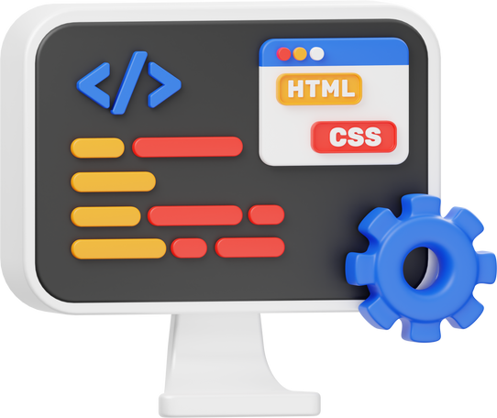

QUELLIFY
Smart way to Learn and Grow
launch the web page
DFD/FLOW CHART of the
Find the scope
Identify
Study
Design the web page
Develope the web page
the goal
"Flowchart outlining the systematic development of our project, step by step."
Content creation

Slide 12
QUELLIFY
Smart way to Learn and Grow
References
Pallets Projects
AOS - Animate on Scroll Library
MongoDB
PowerPoint
Bootstrap
Chatgpt
Font Awesome
Canva for designing

Slide 13




QUELLIFY
A Smart way to Learn and Grow
OUR FUTURE
ENHANCEMENT
Our future Goals
Ai career launcher
PWA for offline access
Talk with experts
MCQ-based assessments
Improve UI/UX design

Slide 14




QUELLIFY
A Smart way to Learn and Grow
Our team
- Tejus Gupta
- Abhishek panwar
- Dhruv Gupta
- Nirdesh Sharma
Backend developer
Frontend developer
Content writer
Graphic designing

Slide 15

QUELLIFY
A Smart way to Learn and Grow

